Slide 1

Housing Price Prediction ….

Slide 2

Problem Statement

Slide 3

?
Problem Statement
Company wants to know:
Which variable are important to predict the price of variable?
How do these variable describe the price of the house?

Slide 4
Objective:
To build a model to predict the house prices with the help of the supporting features .

Slide 5
Conceptual Background
There are many factors that have an impact on house prices, such as the number of bedrooms and bathrooms. House price depends upon its location as well. A house with great accessibility to Highways ,Schools, Shopping Malls, Employment Opportunities, would have a higher price as compared to a house with no such accessibility.
The No Free Lunch Theorem state that algorithms perform differently when they are used under the same circumstances.
The study answers the following research questions:
Research Question1- which Machine Learning Algorithm performs better and has the most accurate result in house price prediction?
Research Question2- What are the factors that have affected house prices in Australia over the years?

Slide 6

Data Sources And Their Formats
There are two data sets given. One is training data and other is testing data.
Train file will be used for training the model that means the model will learn from Train file.
Test file contains independent variable , but not the target variable

Slide 7
Project Flow Chart
Problem Definition
Data Selection
Exploratory Data Analysis
Data Pre-processing
Transformation
Feature Selection
Model Selection
Model Training
Model Evaluation
Model Deployment

Slide 8
Project Flow Tasks Perform
Data Integrity check for presence of duplicate or any data error.
Missing values present in data set. Features containing more than 40% missing value are drop from investigation.
Imputation of missing value with mean, median or mode is performed.
Feature Engineering for extraction of few new features out of existing features.
Feature selection.
Label Encoding of Categorical features.
Splitting of dataset into input and target feature.
Standard Scaling of data.

Slide 9
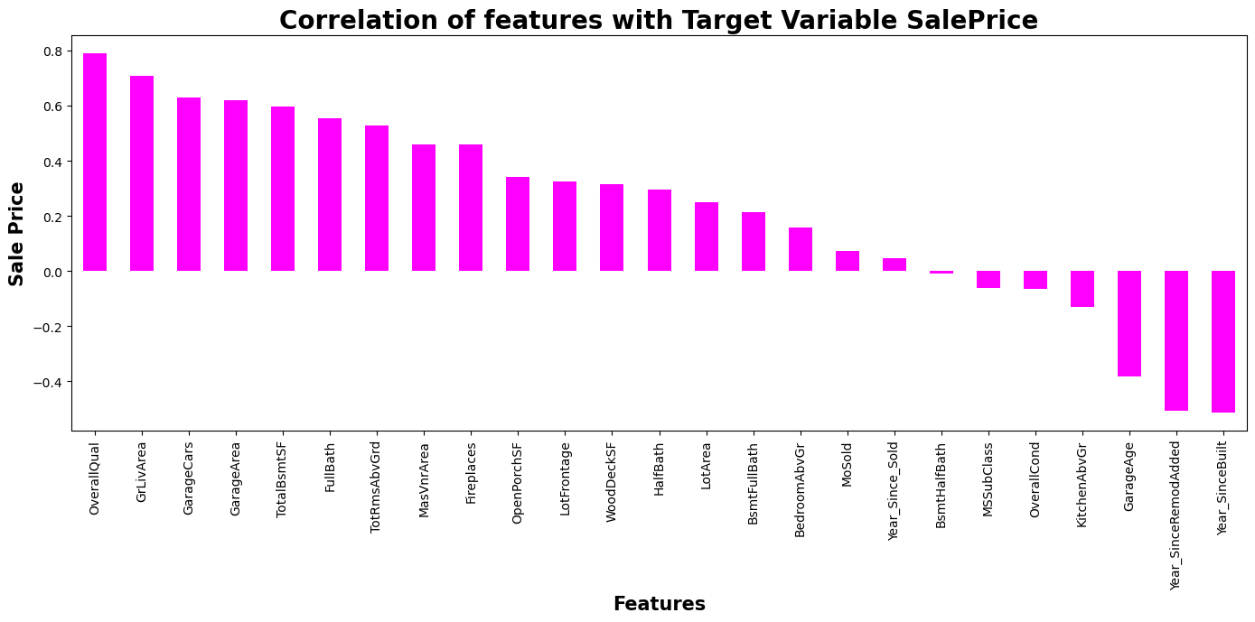
Correlation Heatmap

Slide 10

Exploratory Data Analysis

Slide 11
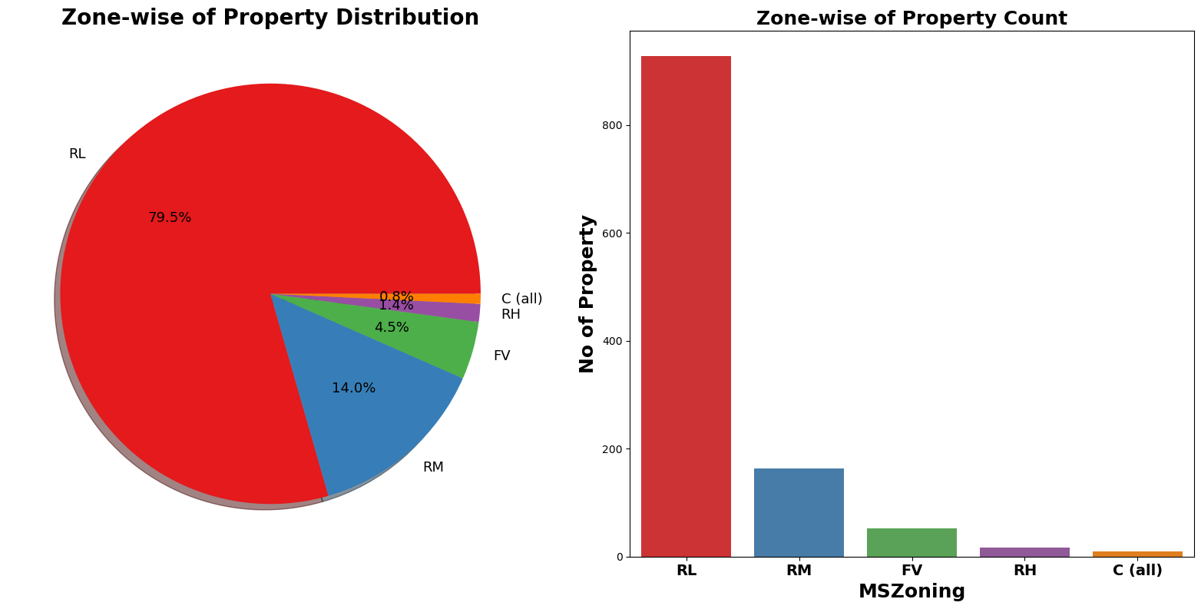
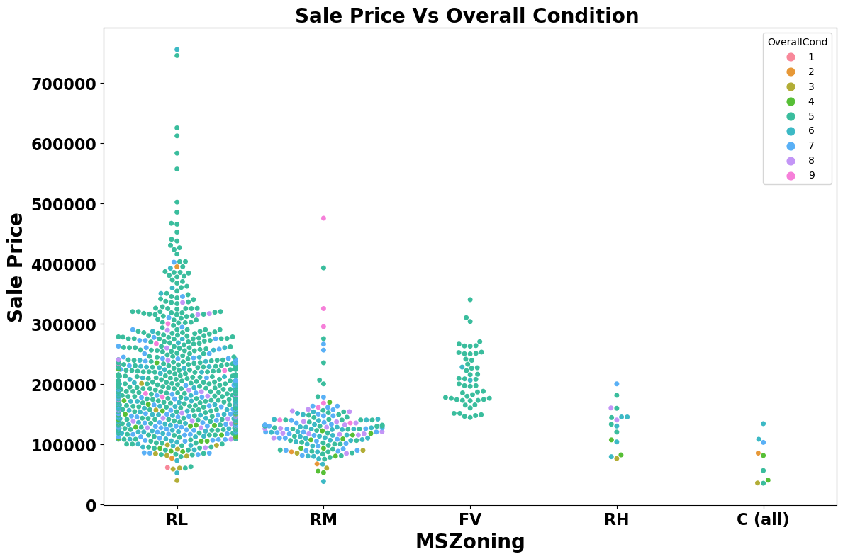
79.5% of House properties belongs to Low Density
Residential Area followed by 14% of properties belong
to Medium Density Residential Area
Very few properties (0.8%) belong to Commercial Zone
Most of property for sale have overall condition rating
of either 5 or 6
We already know of 80%hosing data belongs to Low
Density Residential Area and now can see in Swarm
Plot that Scale Price inside RL Zone is much higher
than another remaining zone.
House properties having Overall condition Rating of 8
and 9 have low price compare to others. This indicate
that Overall Condition Rating is Not significant factor
in determination of Sale price.

Slide 12
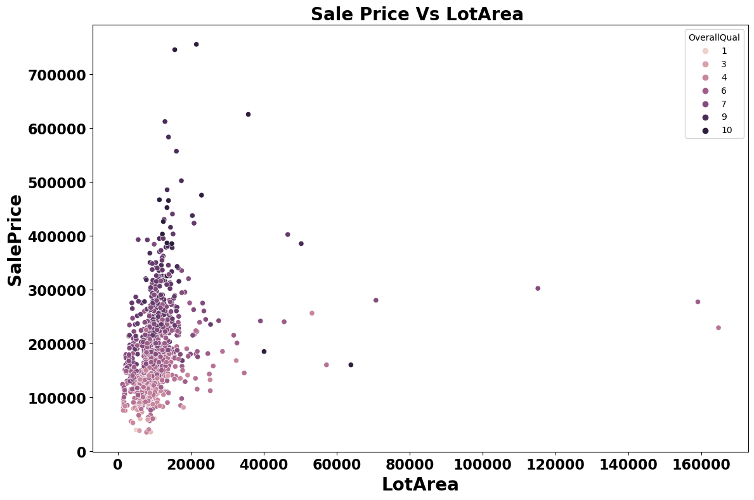
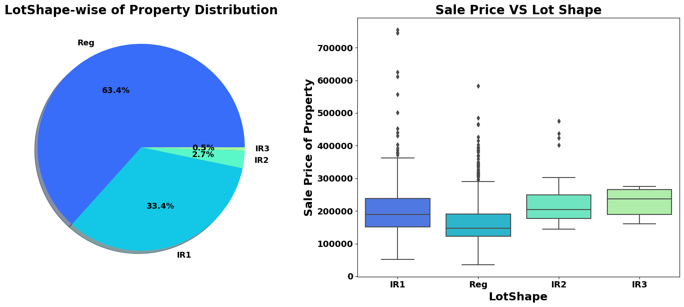
There is No Significant relationship found between Sale
price and Lot area
As Overall Quality of House Increase the Sale Price of
House also Increases
63.4% house properties are regular in shape
Sale Price of property with slight irregular shape
is higher than regular shape.

Slide 13
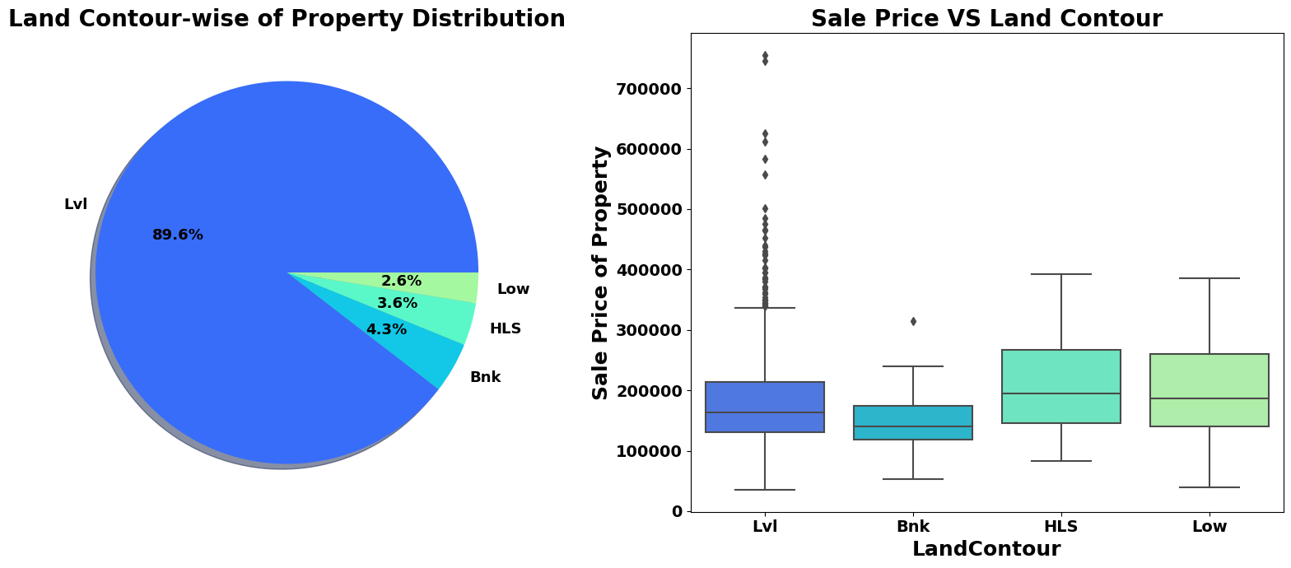
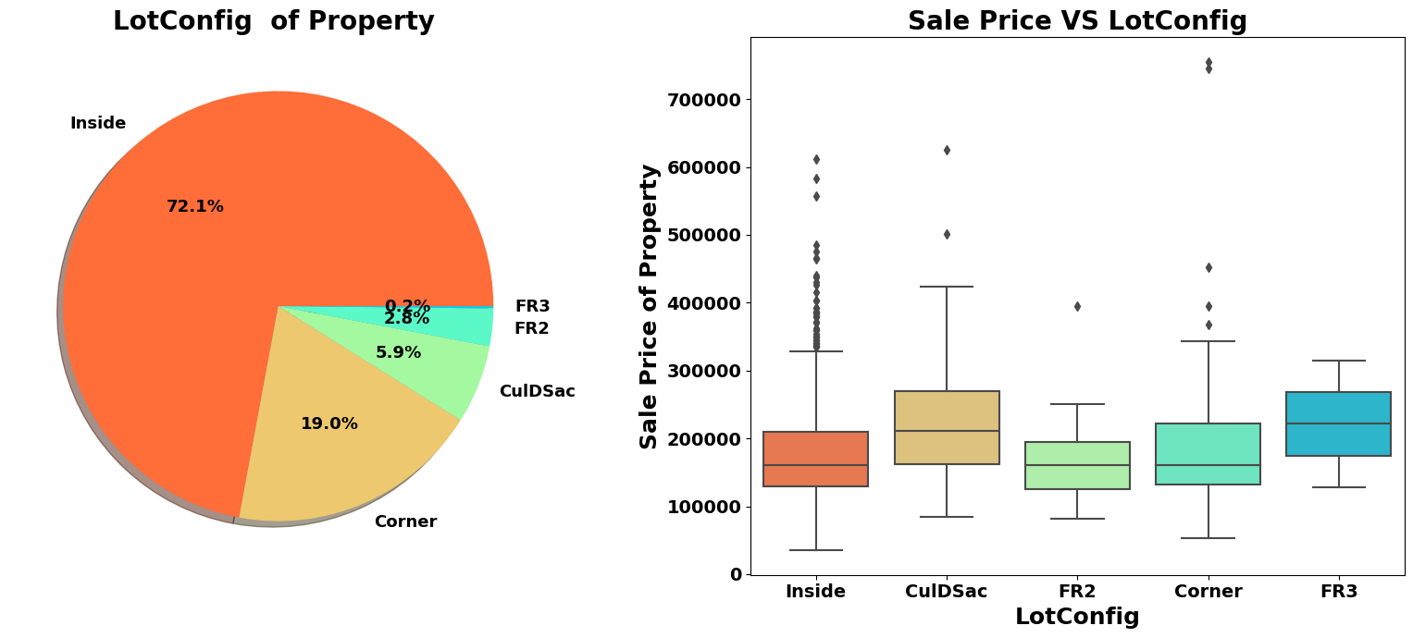
89.6% of House properties are near flat level
Surface.
Also, the price for Flat level surface house is
much higher than other land contour.
Around 72% of house comes with inside Lot
Configuration.
Cul-de-sac has maximum Mean Sale Price
among all Lot Configuration.
Cheapest Houses belongs to Inside Lot
Configuration while Costlier houses belongs
To Corner Lot Configuration.

Slide 14
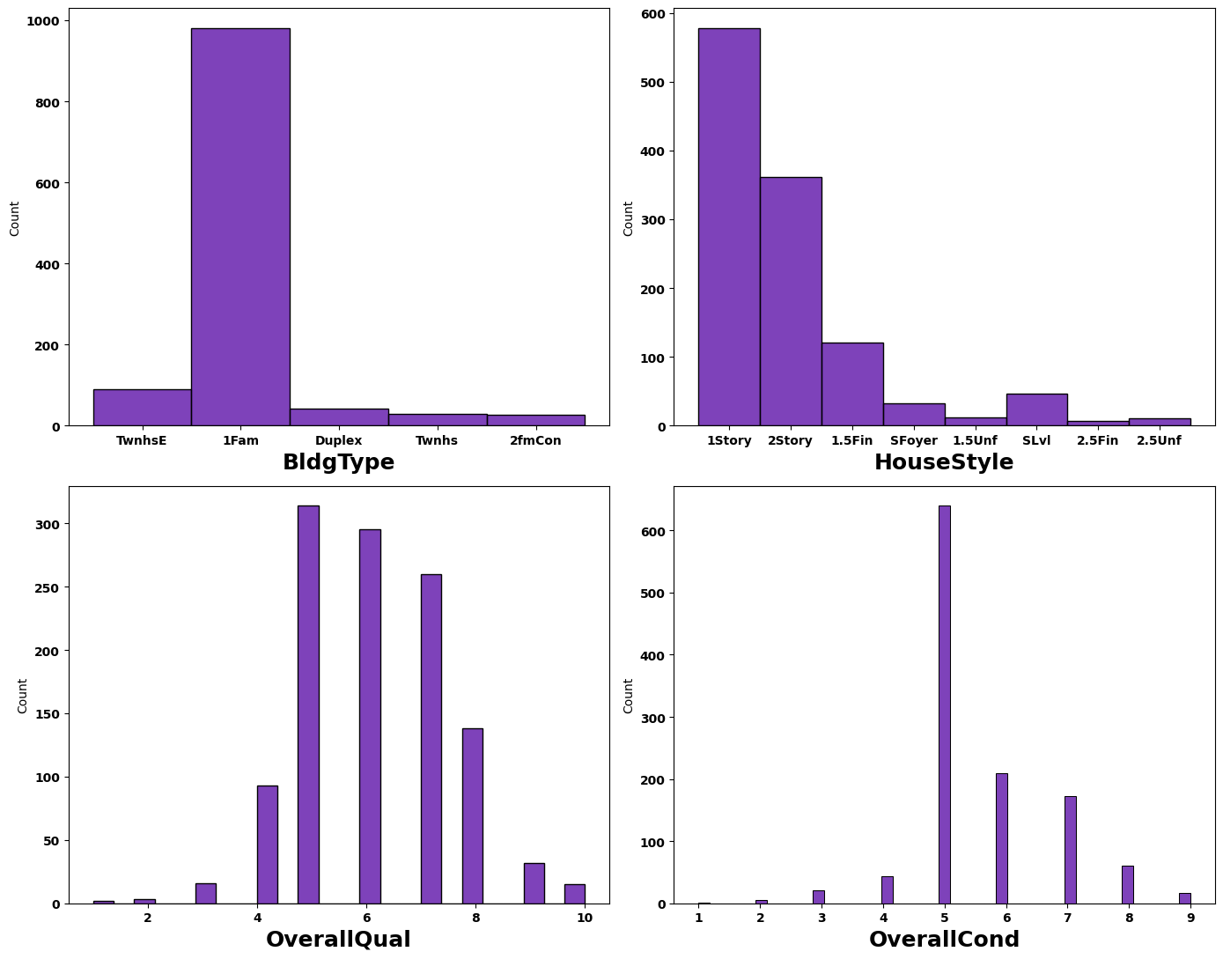
More than 950 houses properties are
with building type Single-family Detached.
More than 50% of house properties
comes with Overall Condition of 5.
More than 75%of house properties come
with overall quality Rating varies between
5 to 6.
More than 500 House Properties comes
with one story dwelling.

Slide 15
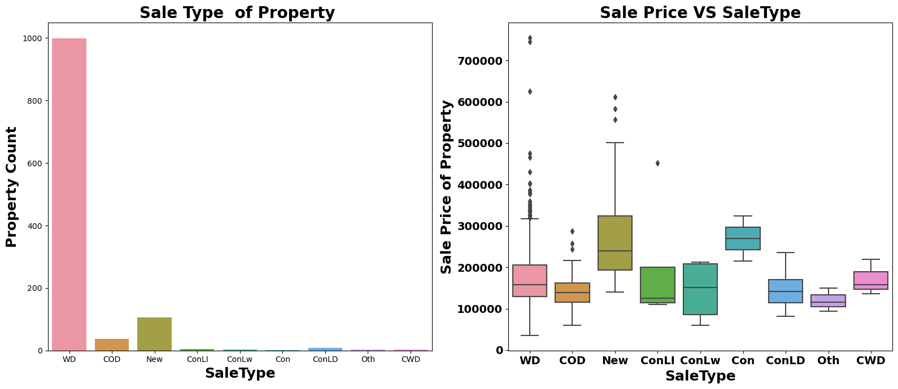
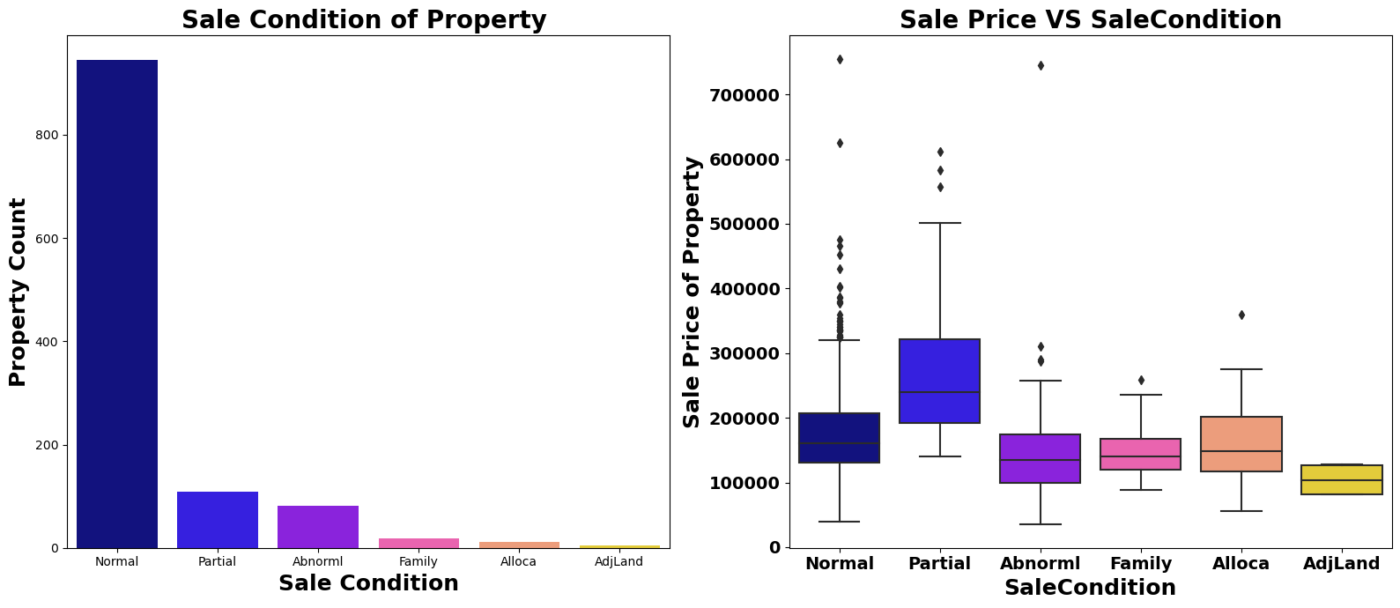
Around 1000 sales happen by Conventional
Warranty Deed.
Home just constructed and sold category are
exceptionally much costlier than anyone else
All loan based sale is below 300000.
We can see that Sale with condition like
Abnormal, Family, Alloca ,AdjLand are below
the price of 300000
Maximum Base Price for House comes from
Partial category- (associated with Uncompleted
New Home) is higher than rest
Minimum base price comes from Normal
condition sale and also highest sale price comes
from this category.

Slide 16
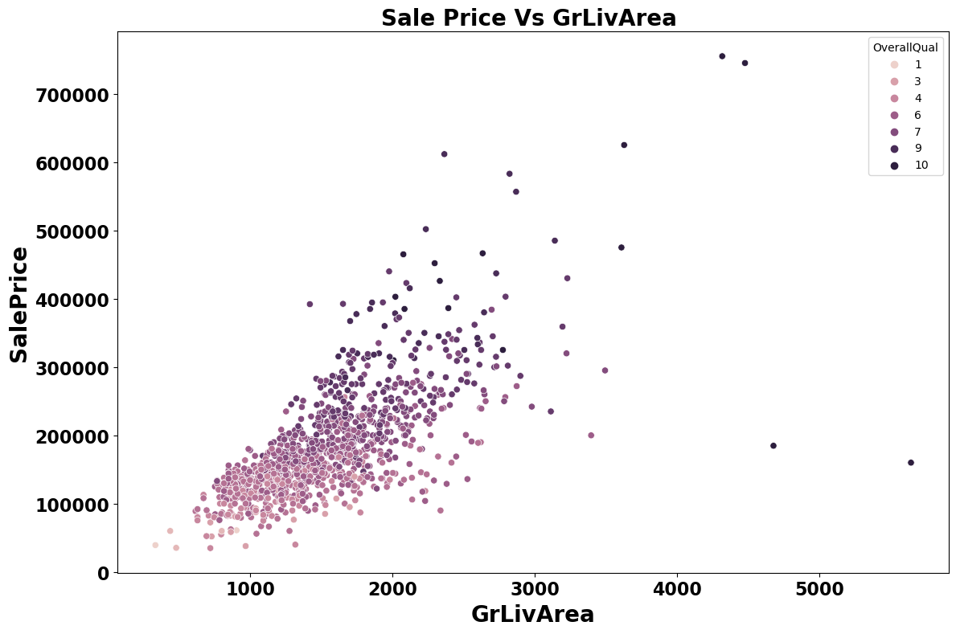
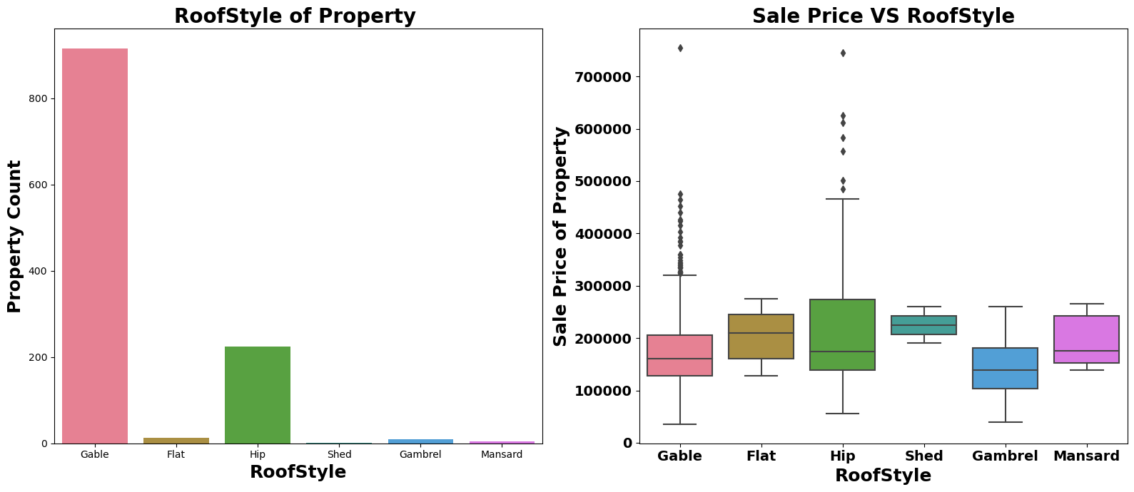
In above plot we can clearly see relation between
all three feature very clearly.
As total floor area increases the sale price also get
increases corresponding the overall quality of House.
More than 75% House properties come with
Gable Roof Style followed by around 15% house
properties with Hip Style.
From Boxplot we can see that Hip Style Roof are
much costlier than remaining roof style.

Slide 17
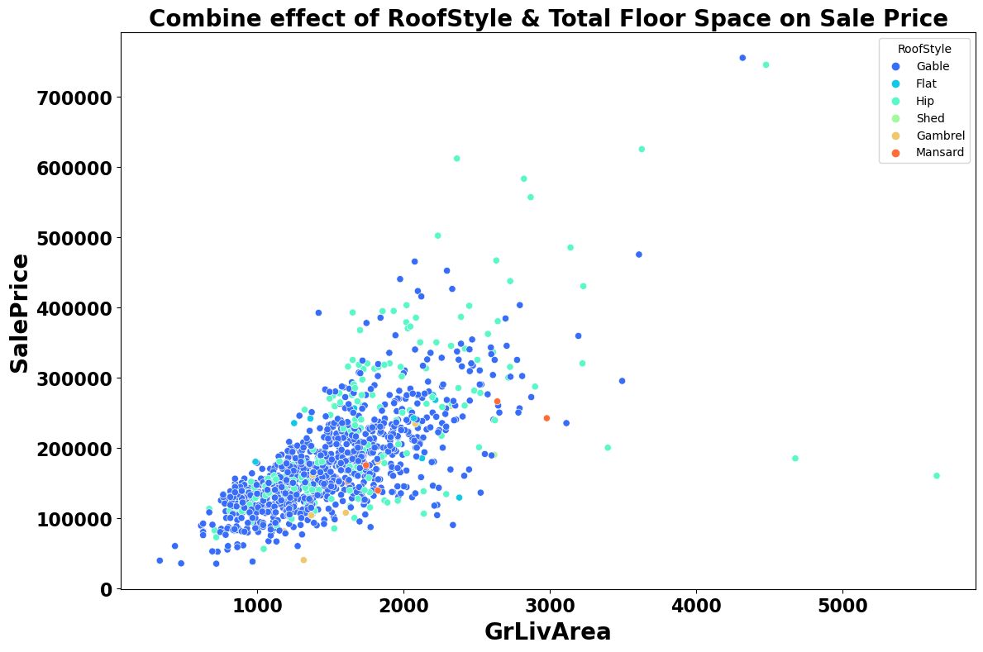
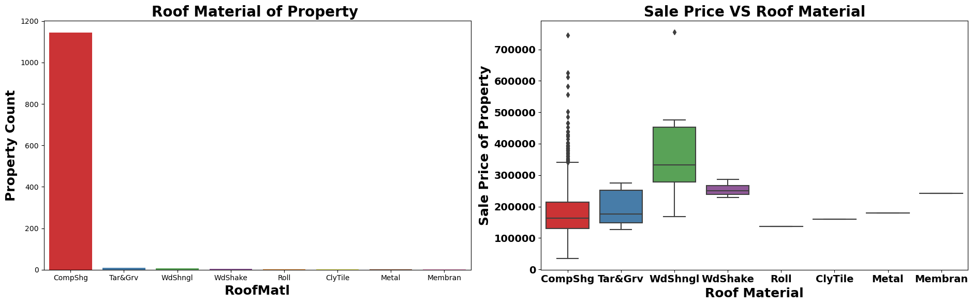
For High Floor area construction mainly Hip
Style Roof is used and invariably high- cost
properties mostly comes up with Hip Style
Roof.
More than 90% Properties in Data set made
With roof material of Standard (Composite)
Shingle
Wood Shingles is Costlier Material compare
to rest.

Slide 18
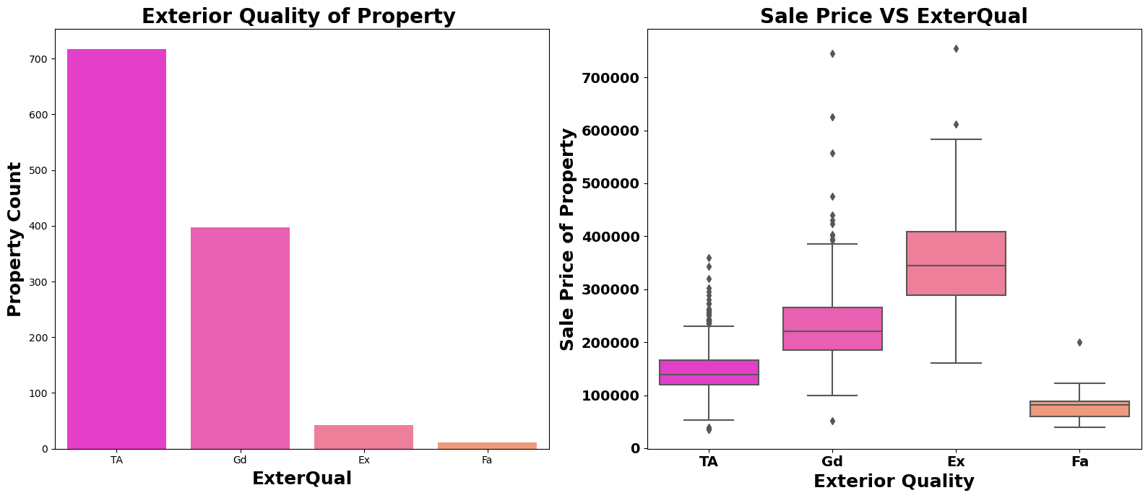
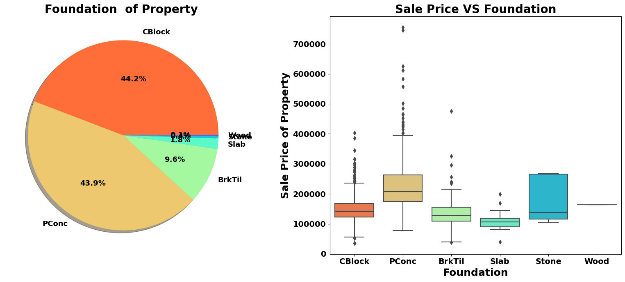
Around 60% of house properties come with
Average Exterior quality and all of them below
400000.
Very few House Properties comes with
Excellent Exterior Quality.
Costlier house properties come with Good
And Excellent exterior quality.
44.2% Properties with CBlock Foundation
And 43.9% housing property come with
PConc Foundation.
PConc Foundation are mostly use in costly
Housing properties.

Slide 19
Machine Learning and Model Building.

Slide 20

Machine Learning Algorithm Used
The different regression algorithm used in this project to build ML model are as below:
Linear Regression.
Random Forest Regressor.
Decision Tress Regressor.
Ridge Regressor.
XGB Regressor.
Extra Tree Regressor.

Slide 21
ML Model Building Flow
Standard Scaling of Data.
Splitting Training Data Using Train_Test_Split.
Finding Best Random State.
Training ML Model on Different Algorithms.
5 Fold Cross Validation of different Model.
Selection of Best Model Based on Evaluation Criteria.
Hyper Parameter Tuning of Best Model.
Saving Final Model Using Joblib.
Predicating Test Dataset using Final Model.

Slide 22
Key Findings And Conclusions Of The Study
Algorithm | R2 Score | CV Score
Random Forest Regressor | 90.27 | 82.89
XGB Regressor | 86.67 | 82.05
Linear Regression | 87.51 | 76.62 %
Decision Tree Regressor | 61.16 | 69.60 %
Extra Tree Regressor | 89.76 | 83.26%
Ridge Regression | 87.52 | 76.66 %
Random Forest Regressor Hyper Parameter Tuned Final Model | 89.57 | 82.O5 %

Slide 23
THANK YOU

